Slide 1
ANALYSING AMAZON SALES DATA
PROJECT 1

Slide 2
INTRODUCTION
Sales management has gained importance to meet increasing competition and the need for improved methods of distribution to reduce cost and to increase profits. Sales management today is the most important function in a commercial and business enterprise.

Slide 3
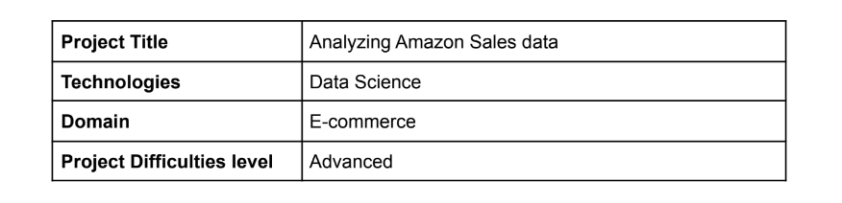
PROBLEM QUESTION
Do ETL: Extract-Transform-Load some Amazon dataset and find for me
Sales-trend -> month-wise, year-wise, yearly_month-wise
Find key metrics and factors and show the meaningful relationships between
attributes. Do your own research and come up with your findings.

Slide 4
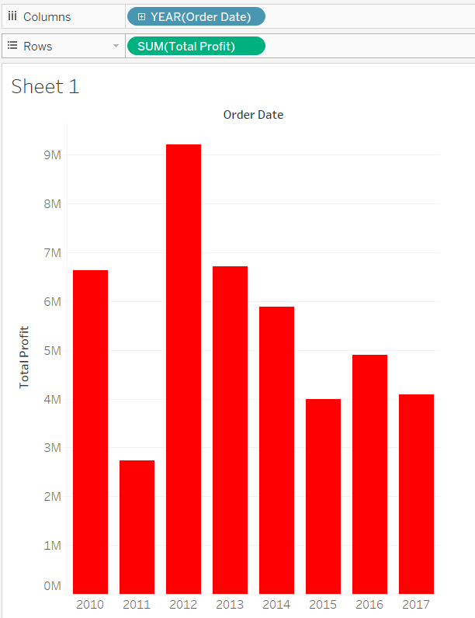
SALES TREND : YEAR WISE
Total profit based on attribute – Order Date [ Yearly ] shows that the company grossed highest profit in the year 2012 crossing 9M whereas lowest profit was made by the company in 2011 of 2.5M.

Slide 5
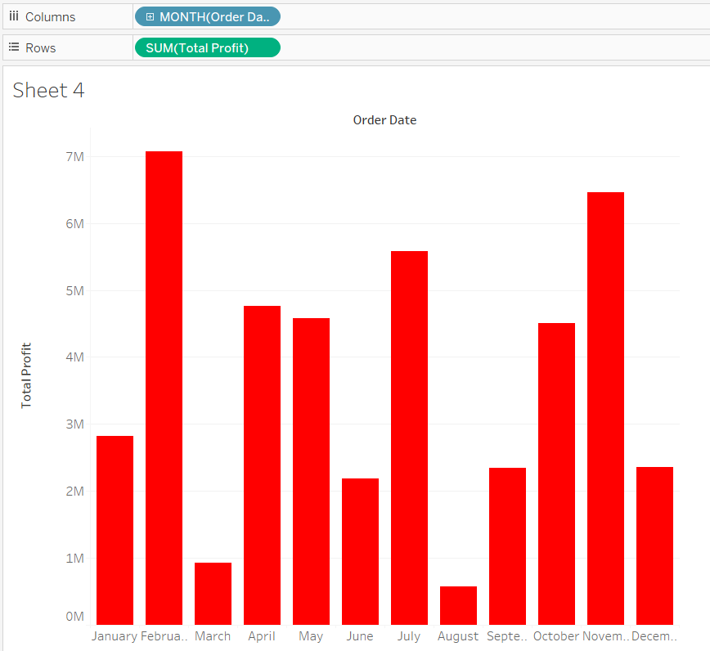
SALES TREND : MONTH WISE
Total profit based on attribute – Order Date [ Monthly ]
shows that February encountered highest profit of 7M+ , closely followed by November (6.5M) . The company noticed lowest profit sale in the month of August with only 0.5M profit.

Slide 6
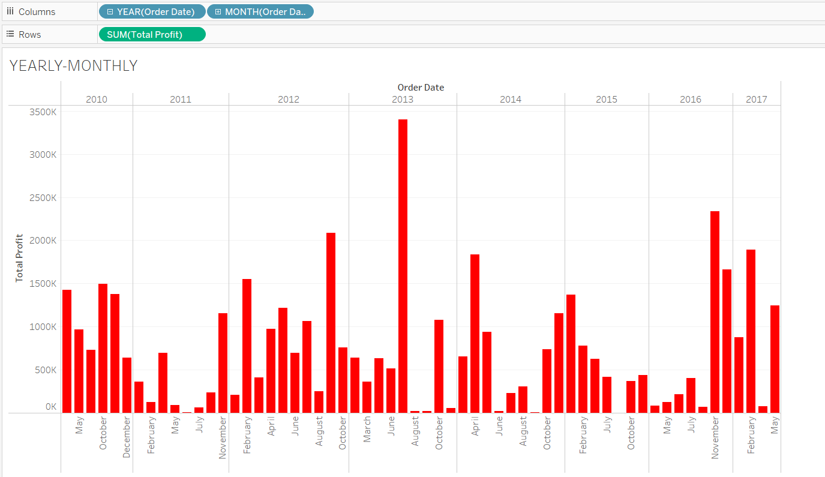
SALES TREND : YEARLY-MONTH WISE
According to the attribute – Order Date [ Yearly- Monthly ] , July of year 2013 showcased maximum profit for the company whereas August of 2015 was noted as the month with the lowest profit in all the years .

Slide 7
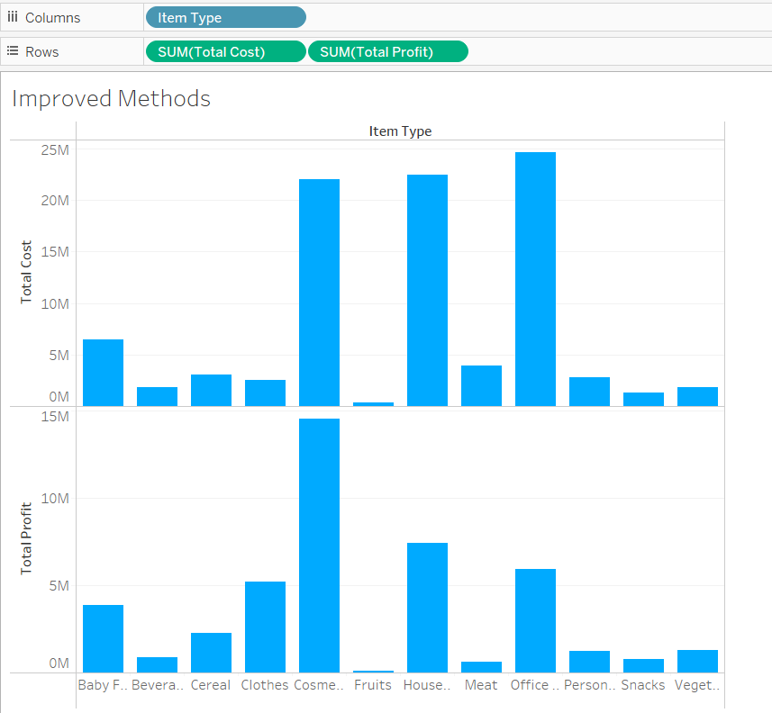
Improved Methods of Distribution To Reduce Cost and to Increase Profits.
Looking through the spectrum of Total Cost and Profit divided by each Item Type, we notice that upon investing on clothes , the company saw maximum profit with minimum investment. In numerical , the profit was up by 2x , with final count at 5.23M .
Another way could be by investing in cosmetics. The company saw profit of 14.5 M with an investment of 22M, which is higher than most profits earned by the company.

Slide 8
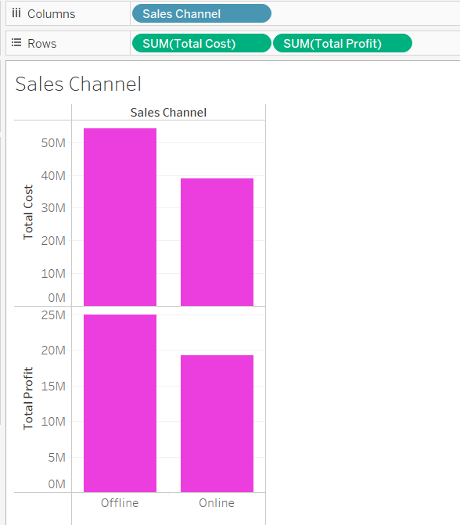
New Findings : Sales Channel vs Total Profit
New findings and research show how total profit is also based upon the attribute Sales Channel. The graph shows that the total profit is greater when the sale is offline rather than online.
The total profit in offline mode accounts to 25M (approx.) , whereas in online mode it accounts to 19.2 M .
One can also see that total cost for sale is greater in offline mode (numerically – 54.1M) than online mode (numerically – 39M).

Slide 9
THANKYOU !
BY : SAMIYA BAKSHI samiyabakshi589@gmail.com

